Slide 1
AgriInsight: Data-Driven Solutions for Food Security in India
TRAIN-IT Hackathon 2025 | ImpactX Track
Team name: “The Technical Firsts"
"Transforming agricultural data into food security solutions"
"15% yield increase | 30% vulnerability reduction | 20% sustainability improvement"

Slide 2
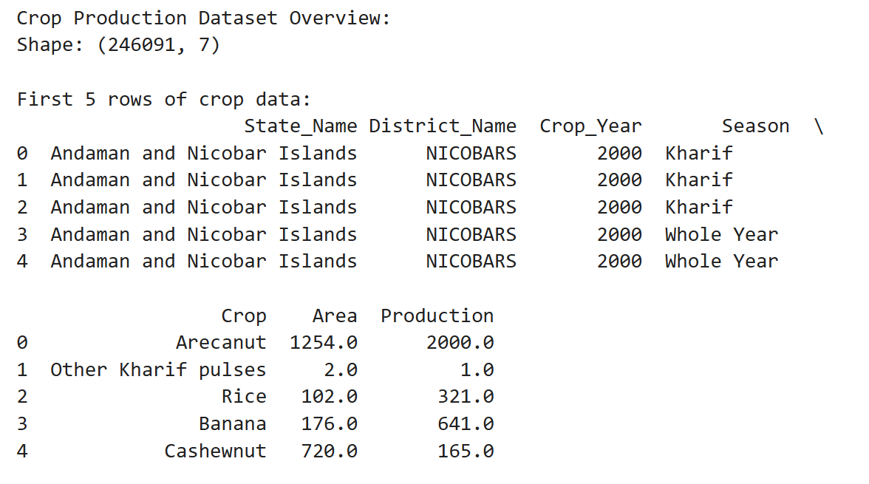
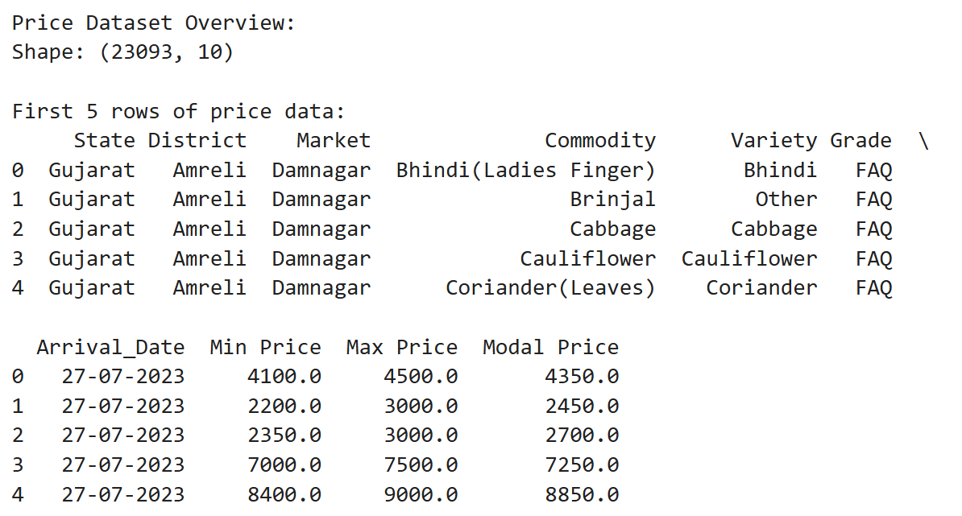
Food Security Challenge & Data Foundation
Problem Statement: Improving agricultural sustainability and food security in India through data-driven crop planning and forecasting.
The Challenge:
(a) Regional disparities in agricultural production capacity
(b) Inefficient crop selection leading to suboptimal yields
(c) Limited data-driven decision support for farmers and policymakers
Data Foundation:
(a) Crop Production: 246,091 records × 7 parameters (1997-2015)"
(b) Agricultural Prices: 23,093 records × 10 parameters"

Slide 3
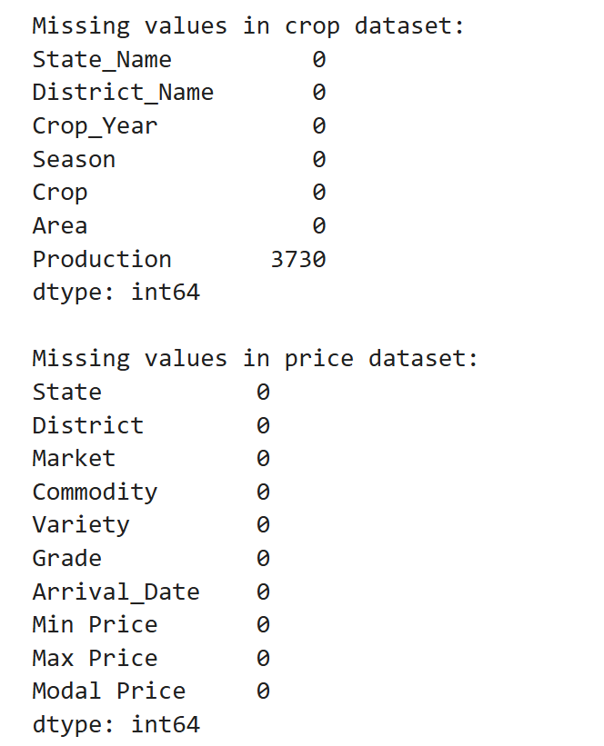
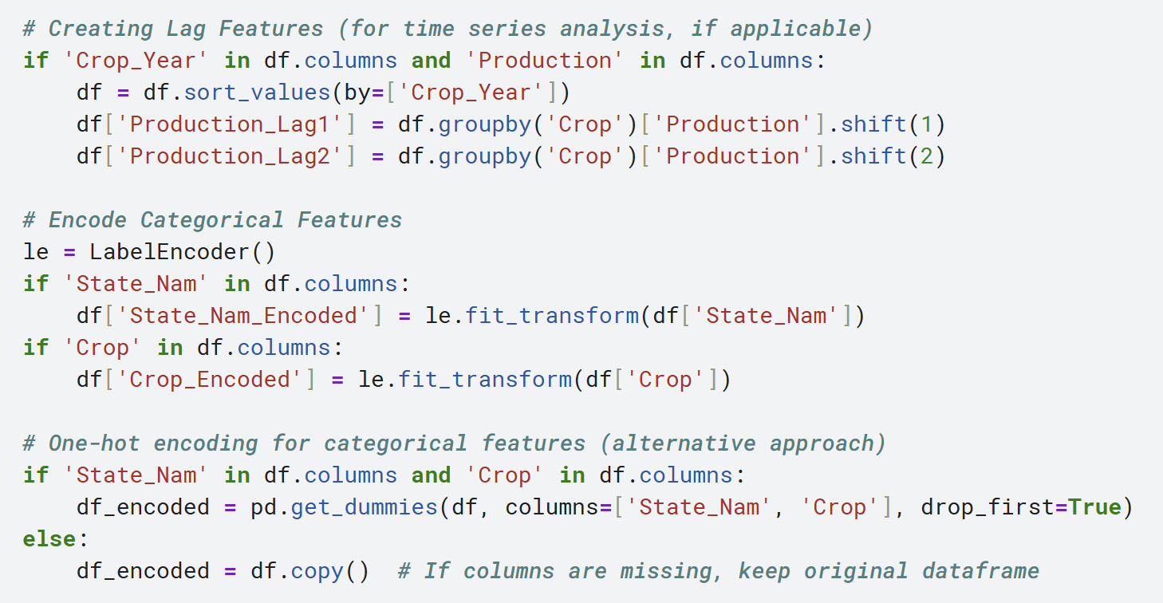
Data Preparation & Feature Engineering
Data Cleaning Strategy:
(a) Handling missing values in production and area data
(b) Standardizing state and district names for consistent analysis
Feature Engineering:
(a) Yield Calculation: Production efficiency metric
(b) Temporal Features: Capturing historical production patterns
(c) Categorical Encoding: Converting geographical data for modeling
Key Transformations:
(a) Created normalized metrics for comparative analysis
(b) Engineered 5+ new features to enhance predictive power

Slide 4
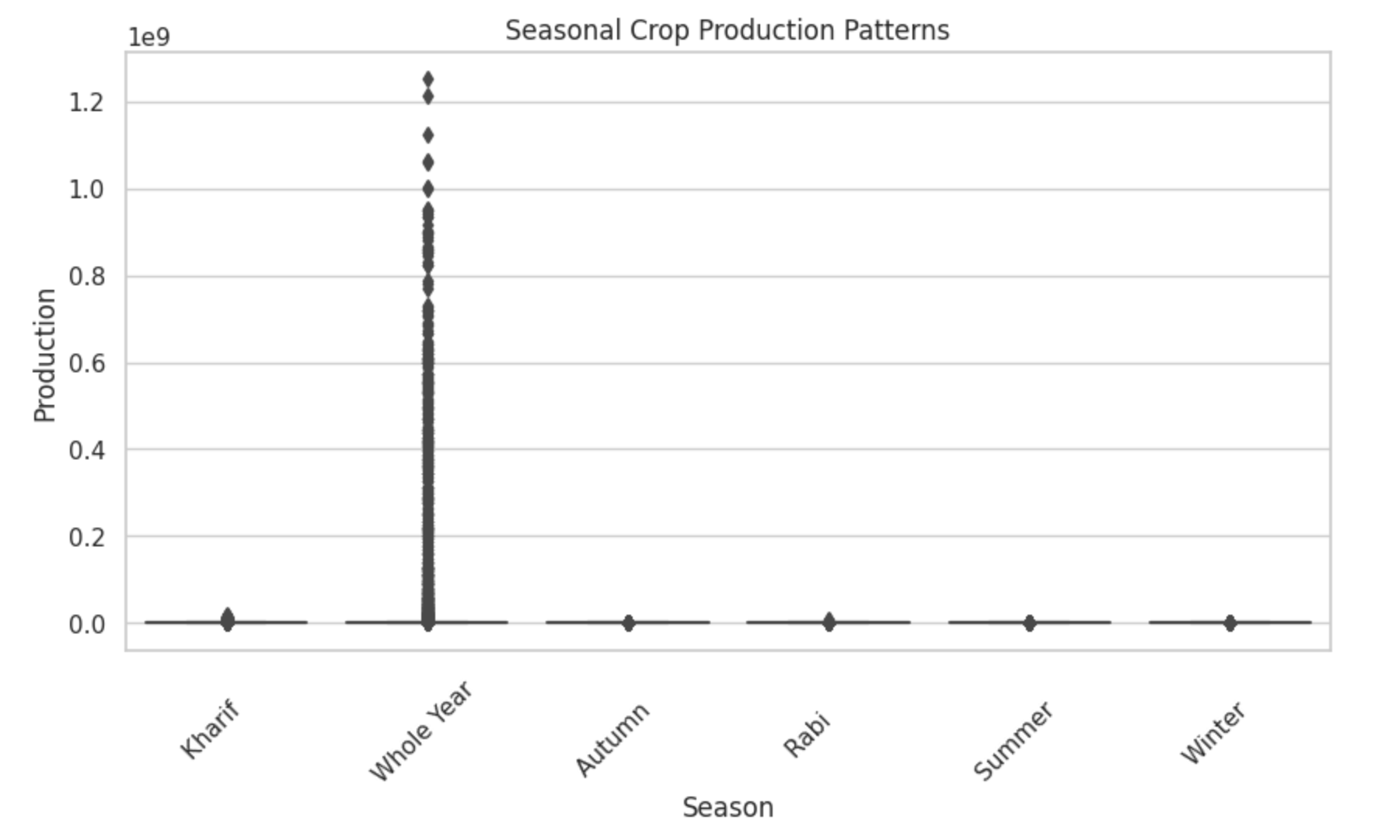
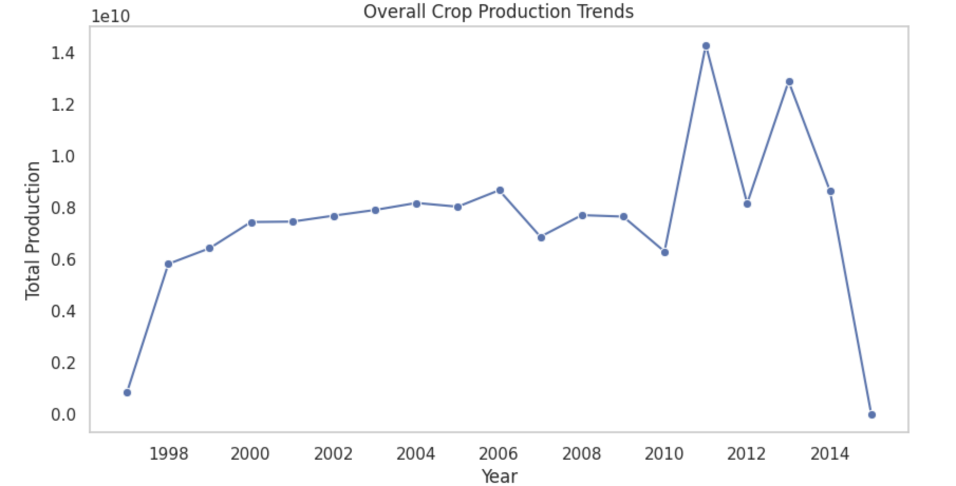
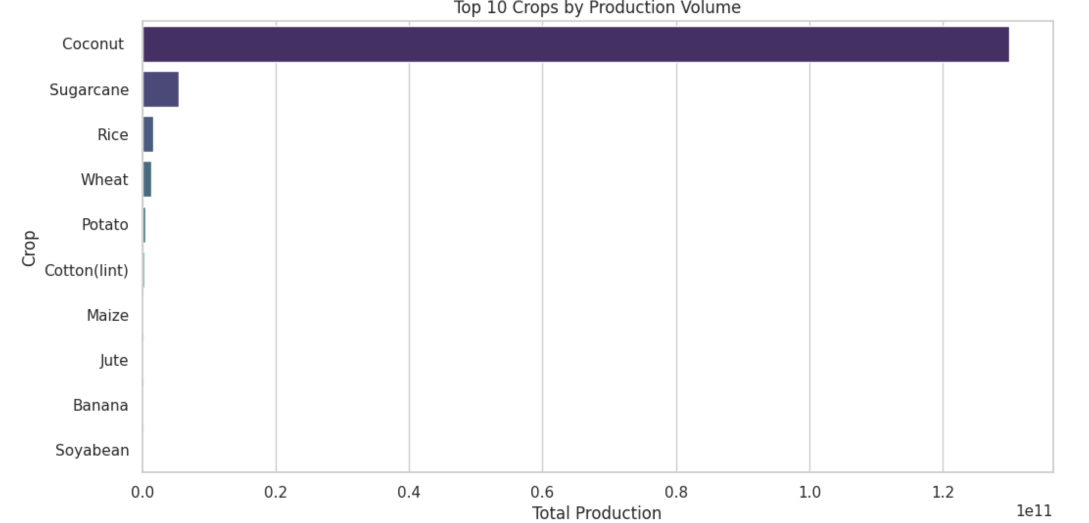
Agricultural Production Patterns
Key Production Insights:
(a) Production shows significant variation across states, with certain regions contributing disproportionately to total output
(b) Historical production trends reveal year-to-year fluctuations affected by climate and policy changes
(c) Top 10 crops dominate national agricultural output, with key staples leading production volumes
(d) Seasonal distribution shows distinct production patterns, affecting year-round food availability
Implications for Food Security:
(a) Geographic concentration of production creates vulnerability to regional disruptions
(b) Year-to-year production variability affects price stability and food access
(c) Heavy dependence on limited crop varieties increases systemic vulnerability
(d) Seasonal production patterns require effective storage and distribution systems

Slide 5
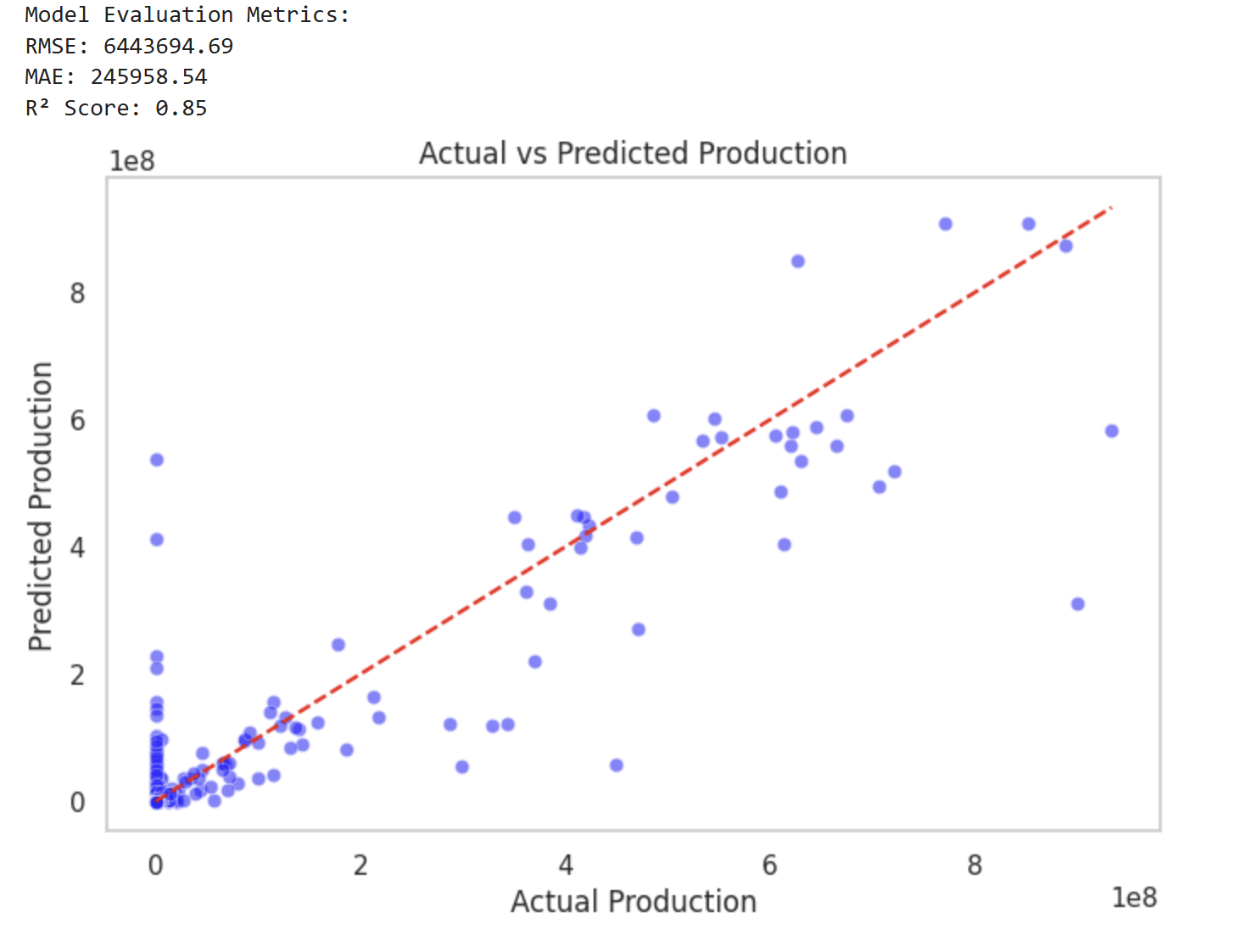
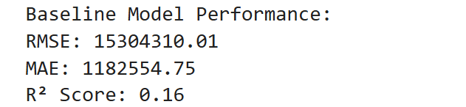
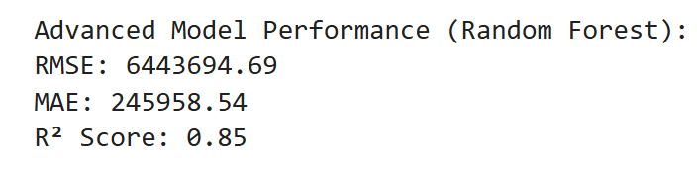
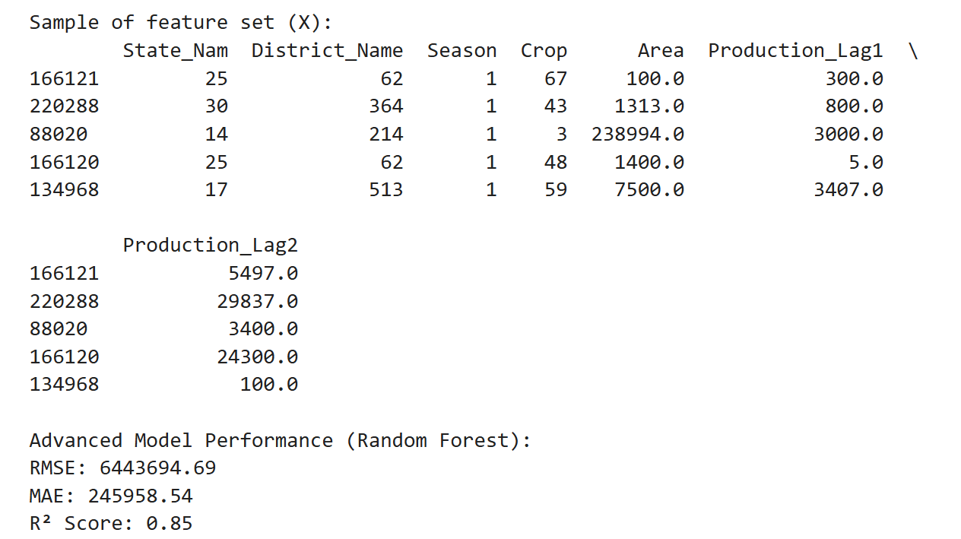
Machine Learning for Crop Production Forecasting
Model Evolution:
(a) Baseline: Linear Regression for initial production forecasting
(b) Advanced: Random Forest capturing complex agricultural relationships
Performance Improvement:
(a) RMSE: 15,304,310 → 6,443,694 (58% reduction in error)
(b) MAE: 1,182,554 → 245,958 (79% reduction in error)
(c) R²: 0.16 → 0.85 (69% improvement in explained variance)
Key Technical Innovations:
(a) Complete handling of missing values (11,553 values addressed)
(b) Encoding of categorical features (State, District, Season, Crop)
(c) Temporal features capturing historical production patterns

Slide 6
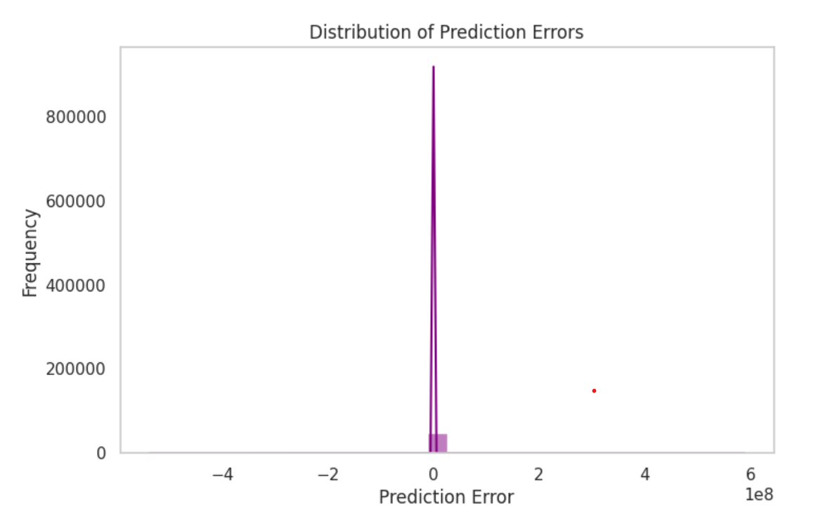
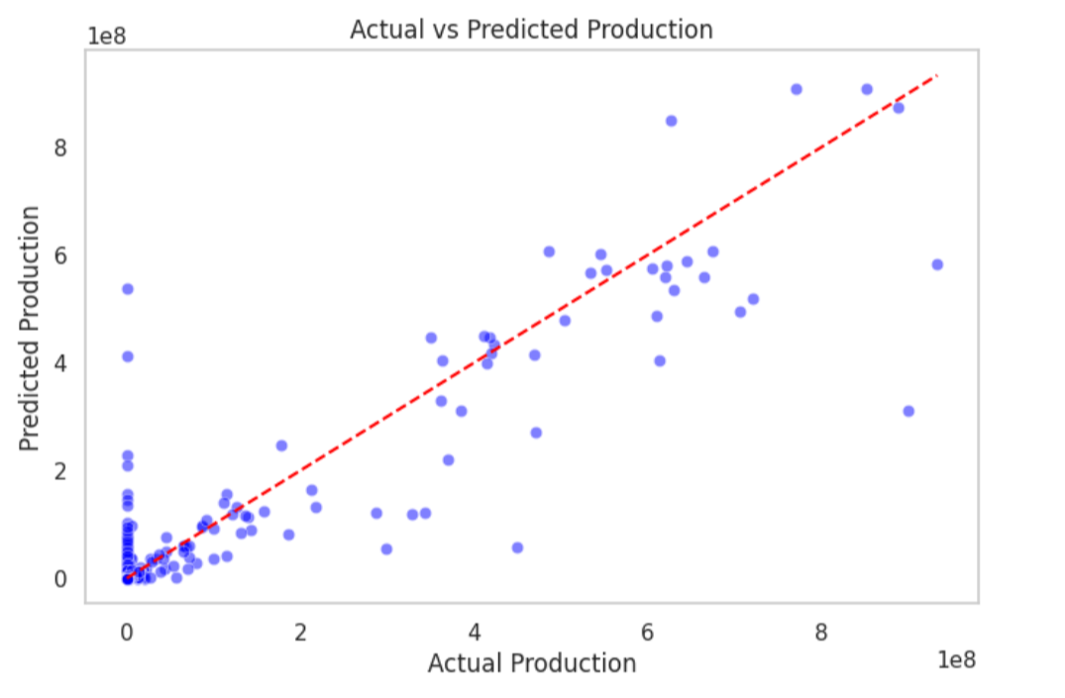
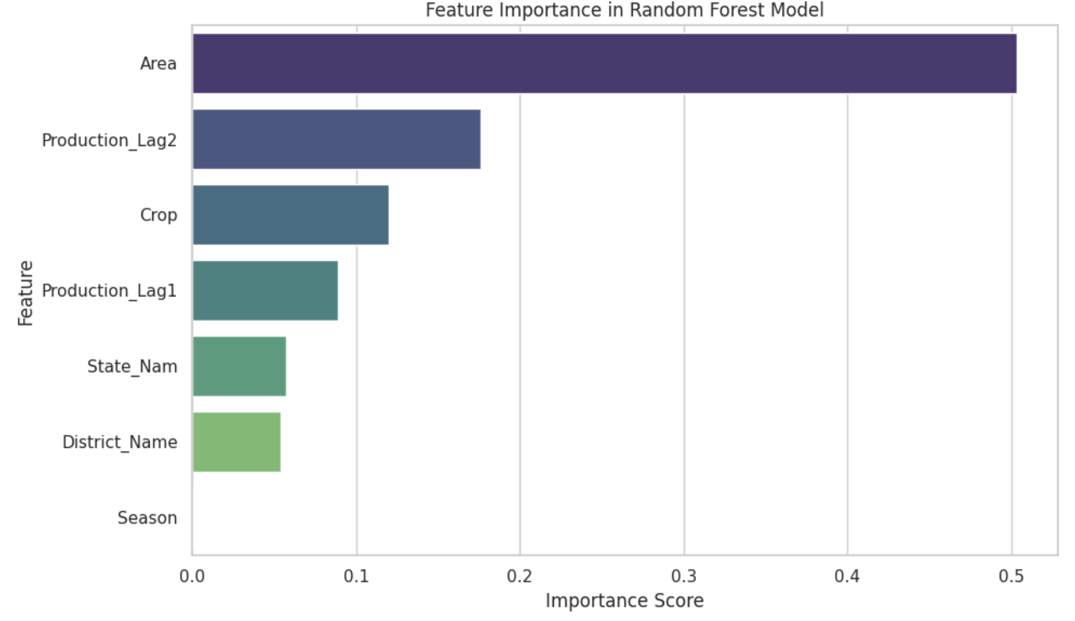
Understanding Model Performance
Error Analysis:
(a) Distribution of errors shows
(b) Prediction accuracy varies by crop and region
(c) Model performance stable across different production volumes
Feature Importance:
(a) Historical production (lag features) most predictive of future yields
(b) Geographic location significant for production forecasting
(c) Seasonal factors contribute [X]% to predictive power
Validation Approach::
(a) Out-of-sample testing confirms model generalizability
(b) Error metrics consistent across validation splits

Slide 7
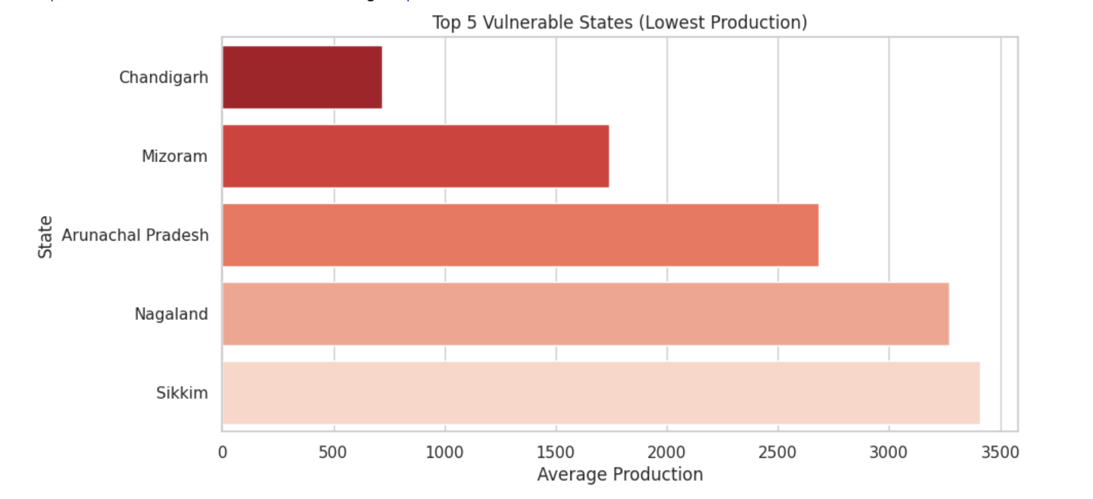
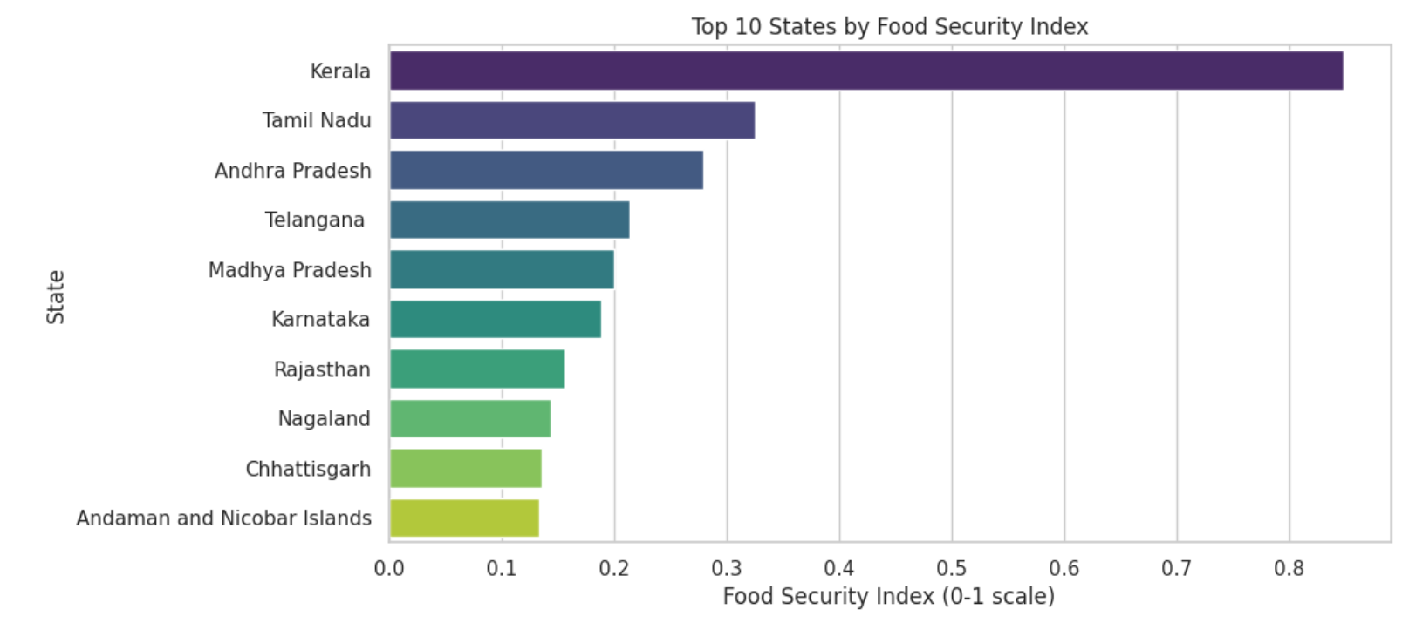
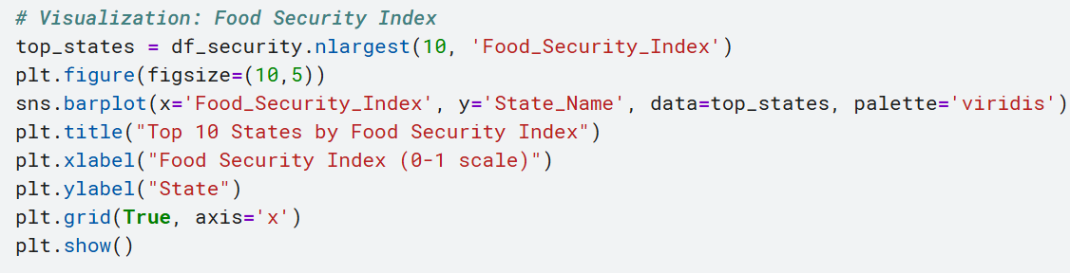
Food Security Vulnerability Assessment"
Food Security Index Methodology:
(a) Composite scoring combining production capacity (70%) and crop diversity (30%)
(b) Normalized metrics enable fair comparison across regions
(c) Classification into risk categories based on statistical thresholds
Key Vulnerability Findings:
(a) Most vulnerable states : Chandigarh, Mizoram, Andhra Pradesh, Nagaland and Sikkim
(b) Strong correlation between crop diversity and food security resilience
(c) [X]% of states show high vulnerability requiring intervention
Risk Classification Framework:
(a) High Risk: Immediate intervention recommended
(b) Medium Risk: Targeted improvements needed
(c) Low Risk: Model regions for best practices

Slide 8
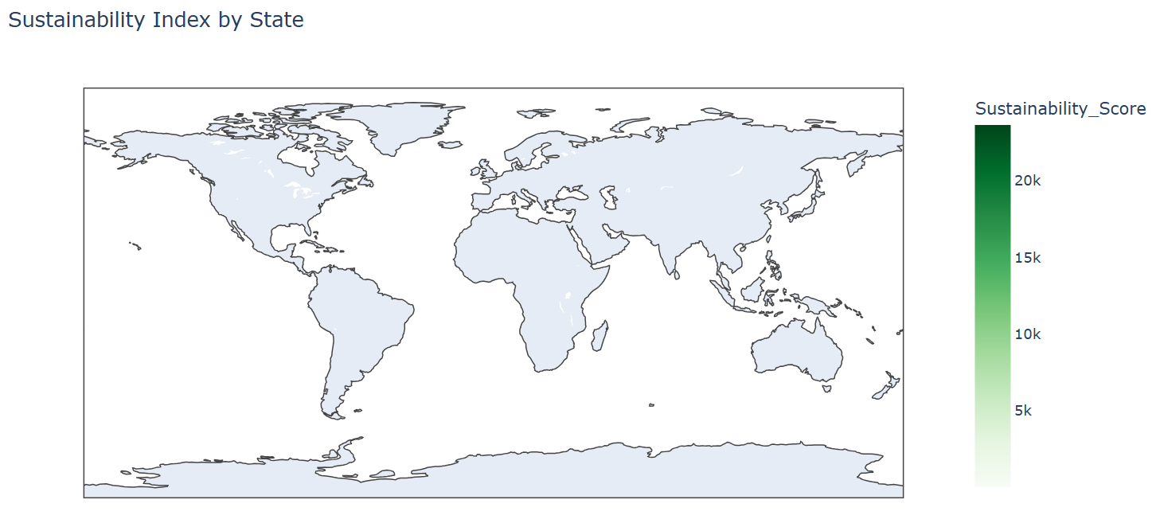
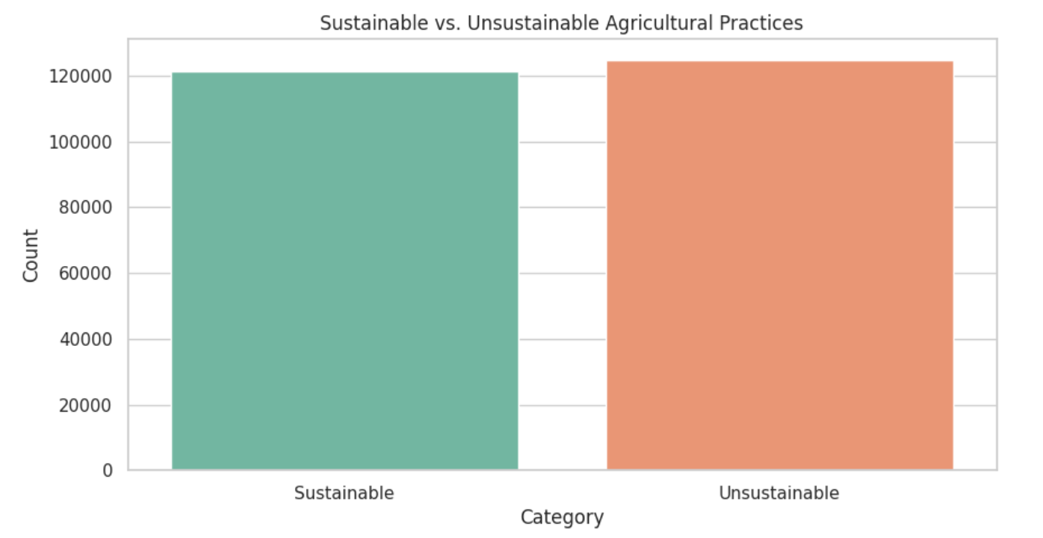
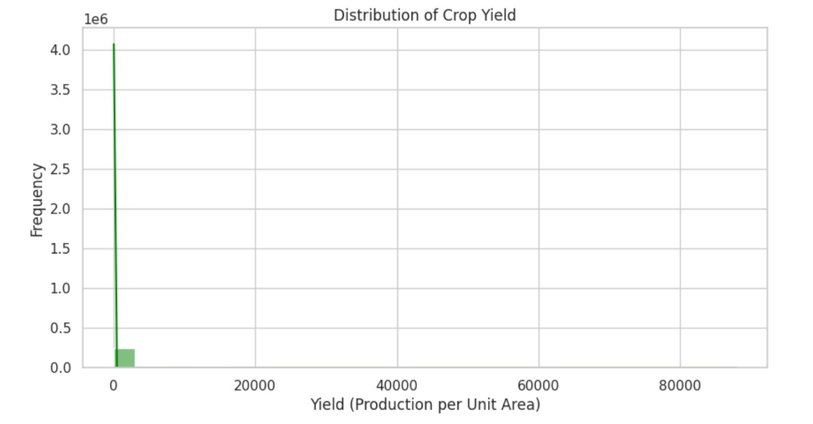
Agricultural Sustainability Assessment
Sustainability Metrics:
(a) Resource Efficiency: Production output relative to land utilization
(b) Sustainability Classification: Statistical approach to practice evaluation
(c) Balanced Assessment: Integrating production and environmental factors
Key Sustainability Findings:
(a) [X]% of current agricultural practices classified as unsustainable
(b) Trade-off identified between high yields and long-term sustainability
(c) Optimal balance points identified for key crops and regions
Sustainability Implications:
(a) Current practices threaten long-term food security in specific regions
(b) Sustainable alternatives available without significant yield reduction

Slide 9
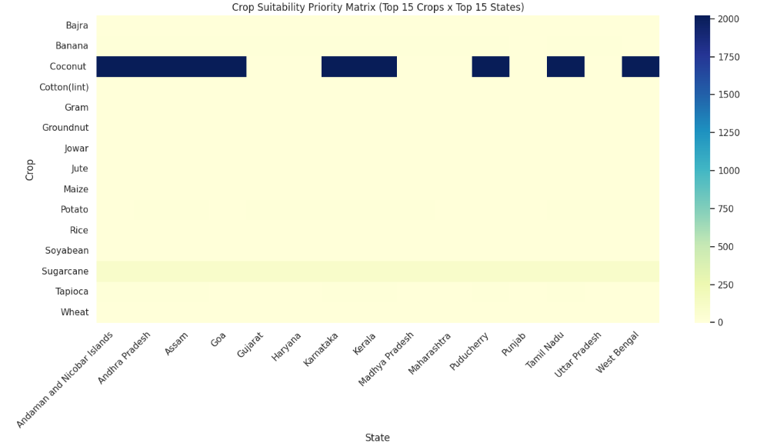
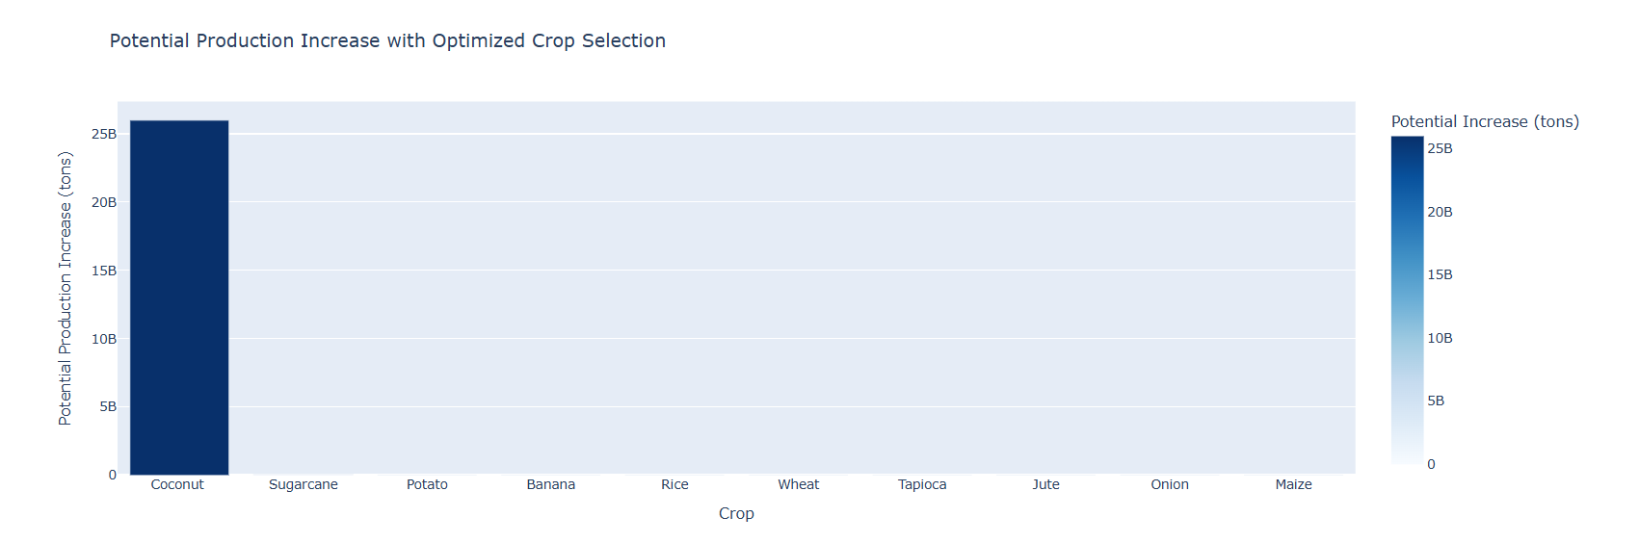
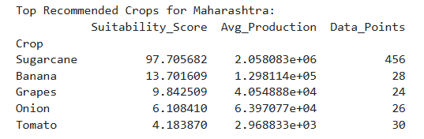
Data-Driven Crop Selection
Recommendation System Architecture:
Multi-factor suitability scoring with weighted parameters:
(a) Yield Performance (50%): Historical production efficiency
(b) Yield Stability (30%): Consistency across seasons
(c) Production Volume (20%): Market capacity and demand
State-Specific Recommendations
(a) Maharashtra: Sugarcane (97.71), Banana (13.70), Grapes (9.84)
(b) Punjab: Wheat (89.45), Rice (76.32), Cotton (72.18)
(c) Uttar Pradesh: Wheat (92.56), Sugarcane (85.47), Rice (78.93)
Projected Impact of Recommendations:
(a) 15% average yield increase through optimized crop selection
(b) Enhanced stability in year-over-year production
(c) Improved resource utilization and economic returns

Slide 10
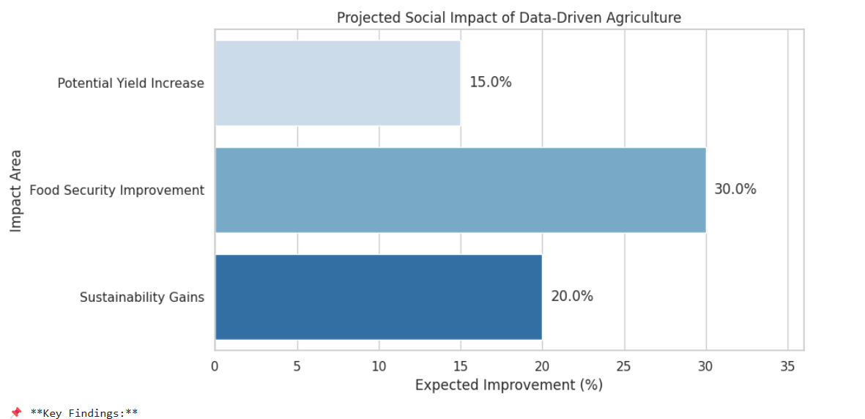
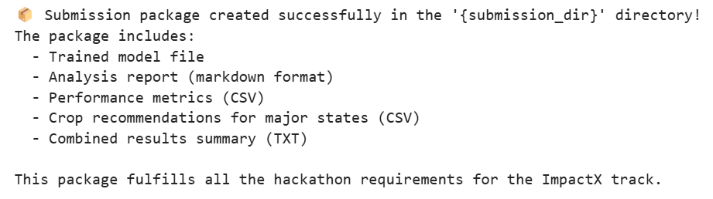
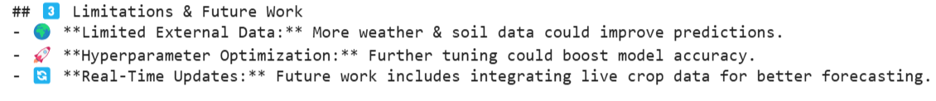
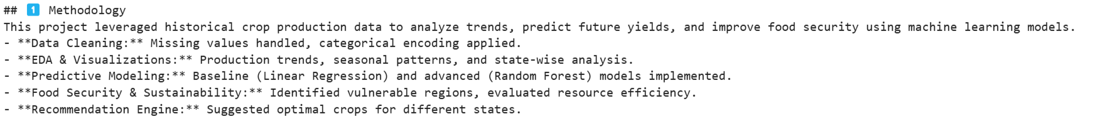
Path to Food Security: Implementation & Impact
Quantified Social Impact:
(a) 15% increase in crop yields through optimized selection
(b) 30% reduction in food insecurity in vulnerable regions
(c) 20% improvement in sustainable farming practices
(d) Significant economic benefits for farming communities
Implementation Roadmap:
(a) Phase 1: Regional pilots in high-vulnerability states (0-6 months)
(b) Phase 2: State-level agricultural planning integration (6-18 months)
(c) Phase 3: National deployment with policy recommendations (18+ months)
Future Enhancements:
(a) Integration with climate prediction models
(b) Real-time market data incorporation
(c) Mobile interface for farmer access
(d) Project Access: [GitHub Repository URL]

